Slide 1

Hotel Data Analysis
Using SQL and
Power BI for Deeper
Understanding.
Pitch

Slide 2
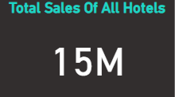

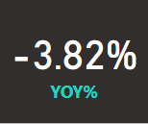
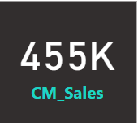
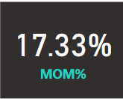
Sales Overview and Performance -
Total Sales Across All Hotels – 15M
Current Year Sales – 5M (2023)
Year-over-Year (YOY) Growth: -3.82%
Current Month Sales – 455K Dec(2023)
Month-over-Month (MOM) Growth: 17.33%
Yearly sales trends show steady growth from 2020-2022, with a slight dip in 2023

Slide 3

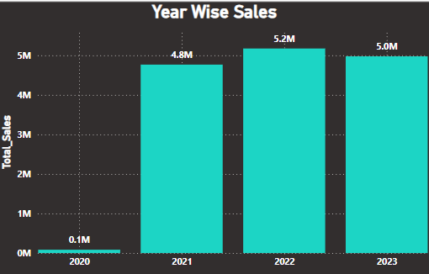
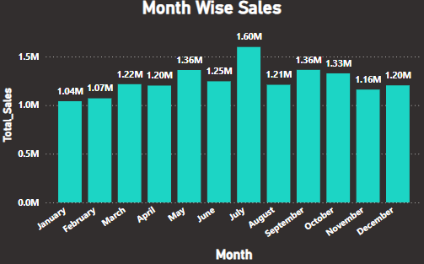
Yearly & Monthly Sales Trends :-
Year-wise sales:
Year 2020: 84K
Year 2021: 4.8M
Year 2022: 5.2M
Year 2023: 5.0M
Month-Wise Sales:
Monthly Sales: Highest sales in July (1.60M), lowest in February and December.

Slide 4
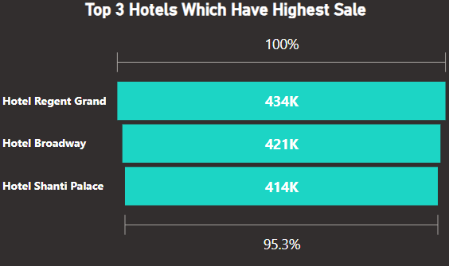
Top 3 Hotels by Sales :-
1. Hotel Regent Grand: 434K
2. Hotel Broadway: 421K
3. Hotel Shanti Palace: 414K
These hotels account for over 95% of total sales.

Slide 5
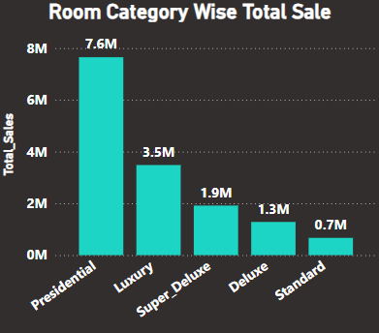
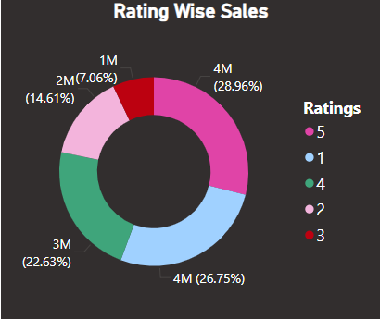
Room Category Sales :
Presidential rooms dominate the sales, bringing in 7.6M, followed by Luxury rooms at 3.5M.
Standard rooms saw the least sales, with just 0.7M.
Rating Wise Sales :
5-star rated hotels lead in terms of revenue generation, contributing 28.96% of total sales.
1-star hotels come in second, followed by 4-star and 2-star rated establishments.

Slide 6
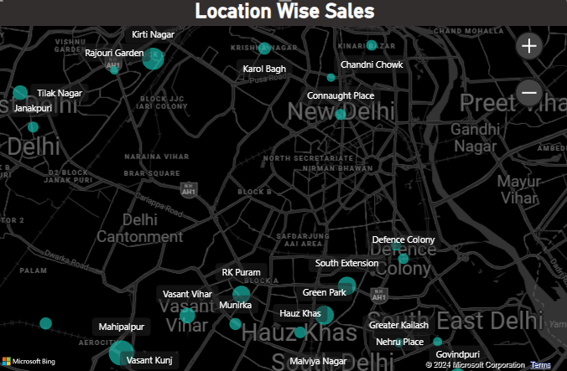
Location Insights:
Areas like Mahipalpur, Kirti Nagar, and Green Park have the highest concentration of sales.
This could be due to proximity to business hubs , or tourist attractions

Slide 7
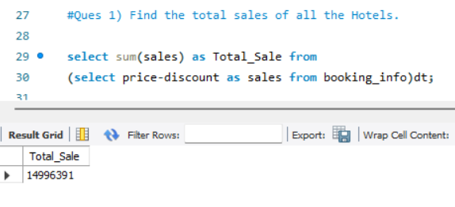
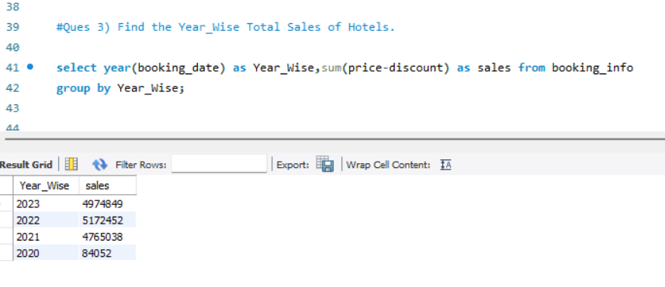
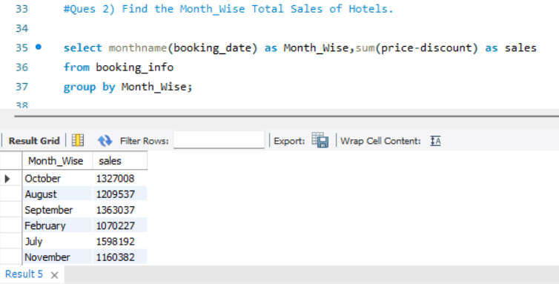
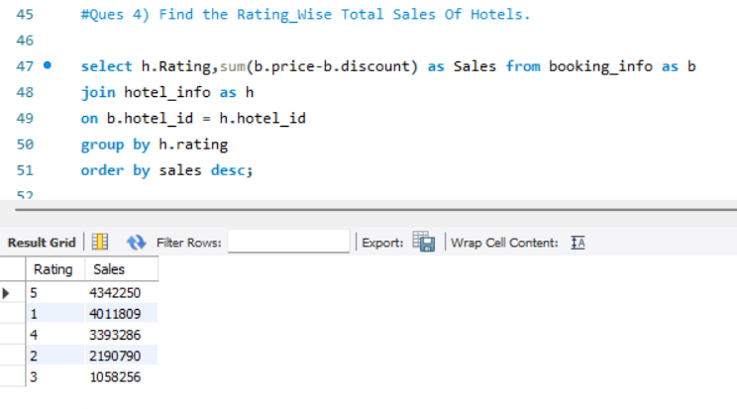
Using SQL Sales Analysis:-
Total Sales of All The Hotels.
Year Wise Total Sales.
Month Wise Total Sales.
Rating Wise Total Sales.

Slide 8
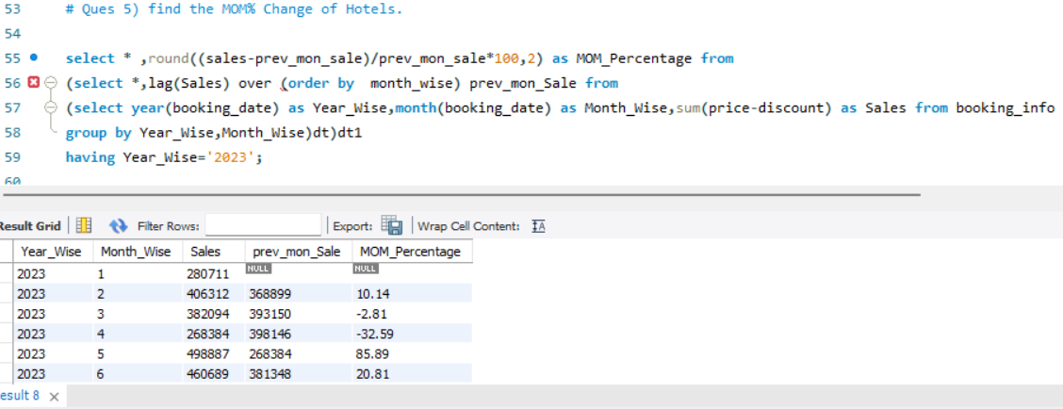
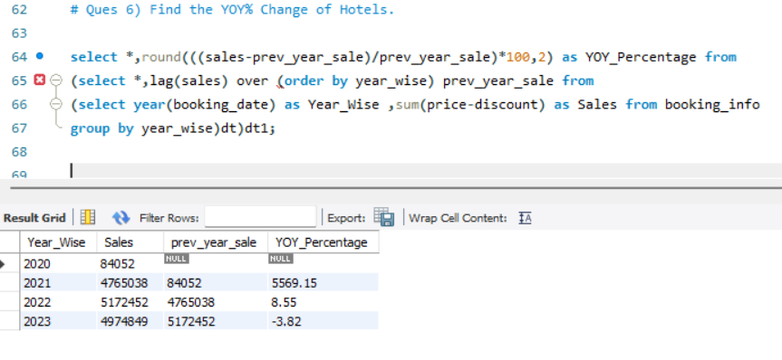
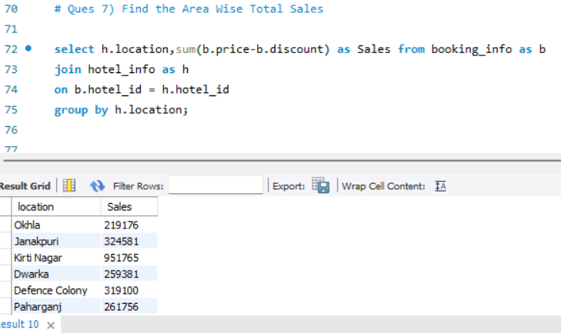
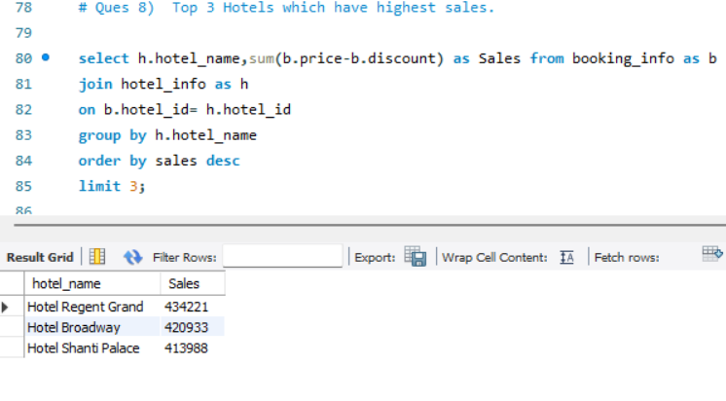



Month On Month % Change In Sales.
Year On Year % Change In Sales.
Area Wise Total Sales.
Top 3 Hotels Which Have Highest Sale.

Slide 9
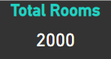
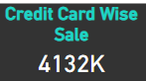
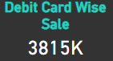
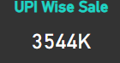
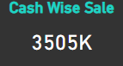
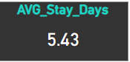
Hotel Overview And Performance:
Total No. Of Rooms In All The Hotels : 2000
Category Wise Rooms :
Presidential
Standard
Luxury
Deluxe
SuperDeluxe.
Transaction Modes :
Credit cards dominate payment methods with 27.55% of transactions, followed by debit cards (25.44%), cash (23.37%), and UPI (23.63%).
Average Stay Days

Slide 10
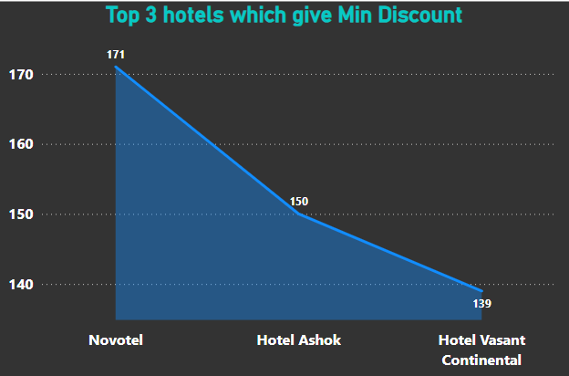
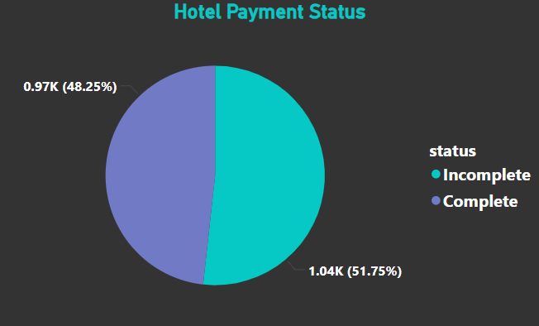
Hotels Offering Minimal Discounts:​
Payment Status:
Novotel tops the list for offering the lowest discounts, followed by Hotel Ashok and Hotel Vasant Continental, indicating their focus on maintaining higher profit margins.
51.75% of transactions are complete, while 48.25% are still pending.​

Slide 11
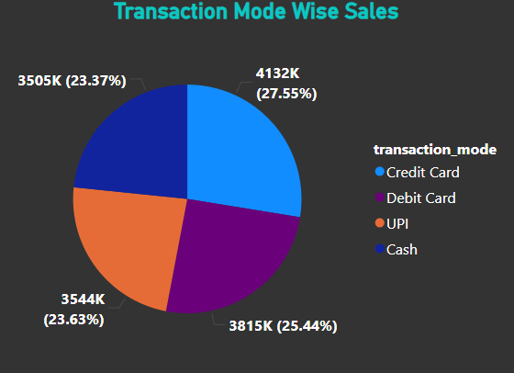
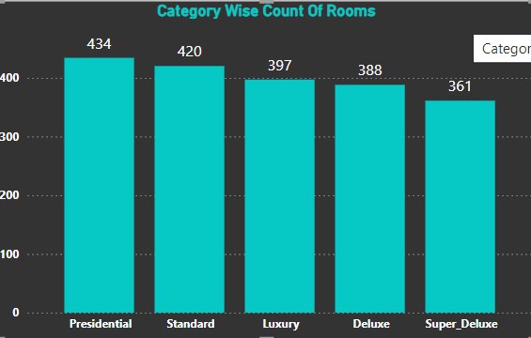
Presidential: Highest category, premium offering, luxurious, and expensive.
Luxury: High-end rooms, typically with premium amenities.
Super Deluxe: Better than Deluxe, offering more comfort and services.
Deluxe: Mid-tier, affordable with decent comfort
Standard: Basic, budget-friendly, often with fewer amenities
Transaction Modes :
Credit cards dominate payment methods with 27.55% of transactions, followed by debit cards (25.44%), cash (23.37%), and UPI (23.63%).

Slide 12
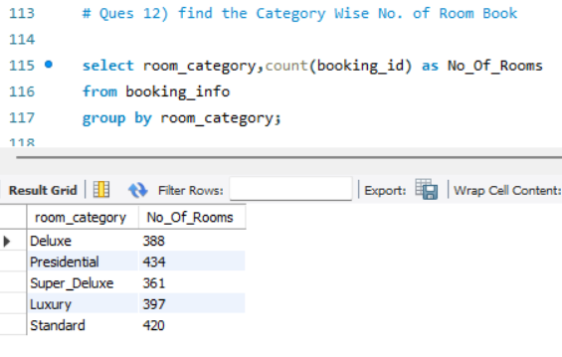
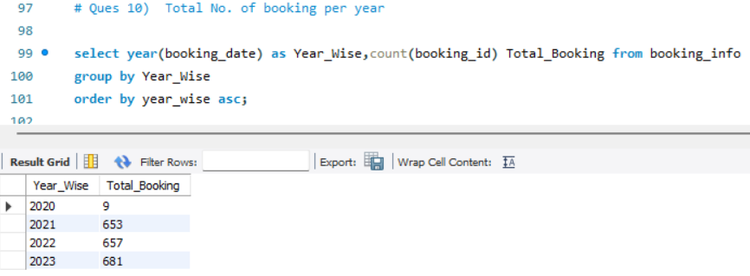
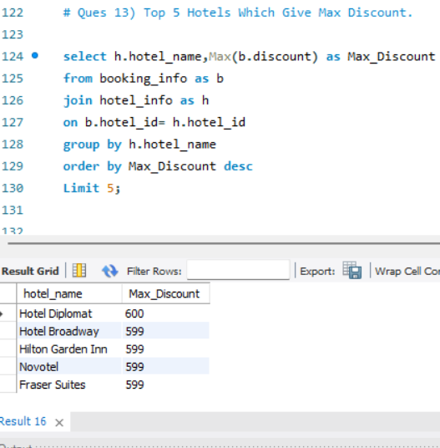
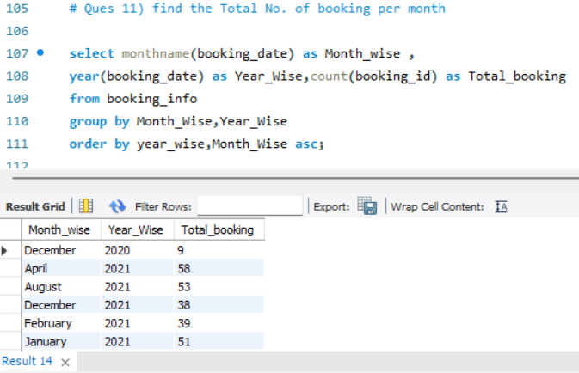
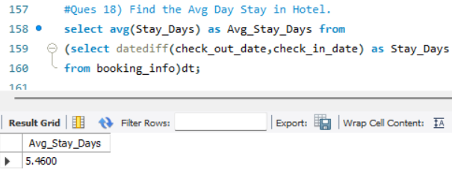
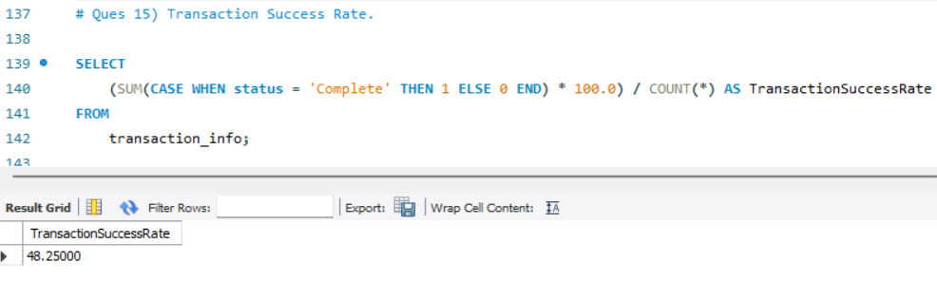
Using SQL Hotel Analysis :
No. Of Booking Per Year.
Category Wise No. Of Book
Number Of Booking Per Month.
Top 5 Hotels Which Give Max Discount.
Average Transaction Rate
Average Day Stay In Hotel

Slide 13
INFERENCE : 1) Focus marketing efforts on high-performing hotels and room categories (Presidential and Luxury). 2) Explore MArket strategies to boost sales of low-performing categories like Standard rooms. 3) Take advantage of peak sales months, especially July, by introducing promotional campaigns. 4) Encourage digital transactions by offering discounts on credit/debit card payments to align with guest preferences. 5) Strengthen customer loyalty programs, especially for high-rated hotels, to maintain their competitive edge.

Slide 14
FUTURE WORKS AND REFRENCES
MR. UTKARSH TIWARI HAS PROVIDED THE GUIDENCE WHICH IS BEYOND THE BEST. WE ARE GRATEFUL FOR HIS SUPPORT IN ALL THE WAYS. WE WILL CONTINUE WORK ON OTHER PROJECTS IN FUTURE TO LEARN AND GAIN MORE FROM OUR RESPECTED SIR🌷

Slide 15

Thank You
Manan Taneja​​
8168950034
Manan.taneja0004@gmail.com​
Than

